Slide 1


CITIZEN’S OVERSIGHT COMMITTEE
September 21, 2018

Slide 2
OVERVIEW:
Current Challenges
  Land & Construction Costs are Too High
  Lengthy Process to Build
  Mismatch Between Available Sites and Favorable Land Use
  Dependence on One Construction Typology
  Dependence on One Methodology to Finance
New Approaches – The solutions must be SIMPLE
  New approaches by Clifford Beers Housing (CBH) and Lorcan O’Herlihy Architects (LOHA)

Slide 3

1. Current
Challenges
Costs are too high
One methodology to finance
One construction typology
Mismatch between sites and favorable land use
Lengthy process to build

Slide 4


Land/Construction Cost Too High
Cost for a Studio unit is between $450,000 and $550,000, with larger units costing more
Land is usually at least 10% of TDC
Given infill construction in LA and typical parking requirements, Parking/Concrete podium is usually at least 7% of TDC
Usually financed w/ 4% or 9% LIHTCs
Smaller PSH projects (under 40 units) cost more
=$500k/Studio

Slide 5
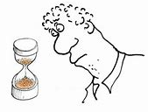
Lengthy Process to Build
One building takes approximately 5-6 years to develop
Given programmatic requirements (leveraging) with public $’s, it takes too long to assemble capital stack
Given the mismatch between available sites & favorable land use TOC/entitlements, it adds time

Slide 6
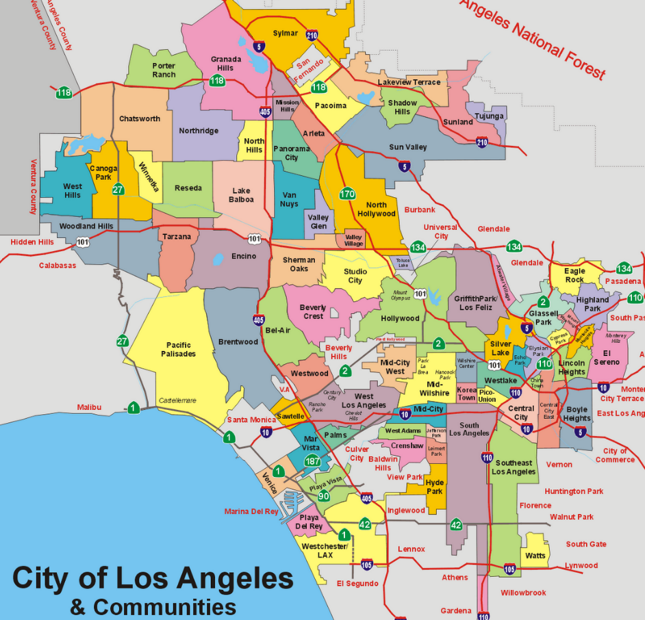
Mismatch between Available Sites & Favorable Land Use / TOC/ Entitlements
This could be significantly higher given proximity to Van Nuys light rail not yet built
Current RFP
Address: 14545 W. Lanark Street Panorama City
Zoning: (Q)M1-1-CDO
TOC: Tier 1
Lop Parcel Area: 75,000 sq. ft. (1.72 acres)
Given the rarity of this large lot, this could be subdivided for multiple developments, once higher Tier TOC is achieved
Average 9 months to rezone plus exposure from opposition due to public hearing

Slide 7
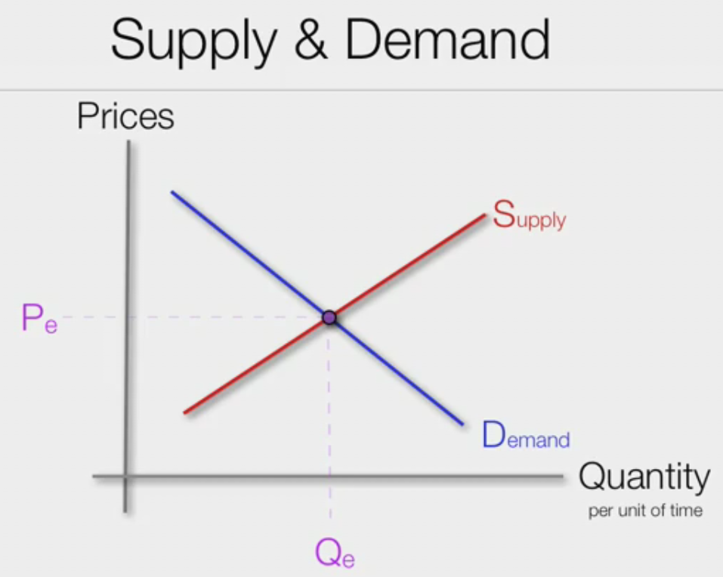
Dependence on One Construction Typology
  As a result of LA’s continued construction demand (residential, commercial & infrastructure), notwithstanding demand from recent fires, this has resulted in higher costs specifically from construction materials and from a lower pool of subcontractors in built-up Type V construction, which is the typical method of building PSH. It is simply a function of supply and demand.

Slide 8

Dependence on One Product/Methodology
to Finance
Most PSH built today in the City of LA is financed via the 4% Low Income Housing Tax Credit (LIHTC), which accounts for approximately 35% of the capital stack. Given the structure of the LIHTC program, PSH works best when the deals are bigger and, therefore, smaller projects are disincentivized and really small projects (under 15 units) are simply not built.
Alternative financial models, without LIHTCs, do not exist because replacing 35% of the capital stack would add more time to the already lengthy process and those financial products are not readily found in the affordable housing marketplace. Therefore, innovation has not occurred. Additionally, given the large suburban nature of Los Angeles, typical LIHTC deals (over 40 units) do not fit the land use profile of lower density neighborhoods.

Slide 9

New Approaches - The Solutions must be SIMPLE

Slide 10
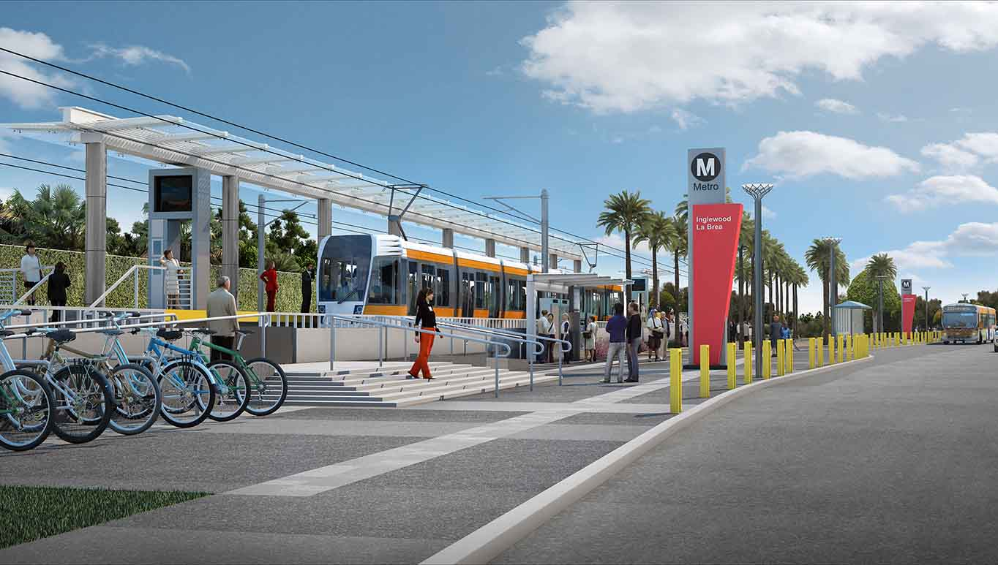
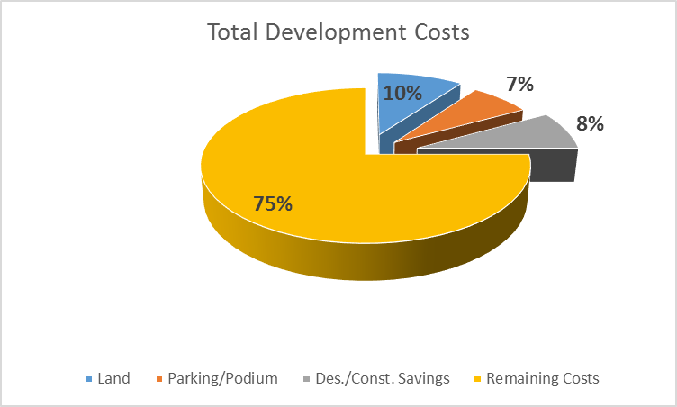
Cost Saving Approaches
  Local jurisdiction to donate land in RFPs / Dispositions
  (OR)
  Local jurisdiction to remove land costs from capital budget by negotiating a long-term ground lease for a de minimis price
  Faith Based Institution or private seller to negotiate long term ground lease rather than straight acquisition
  Remove parking/construction podium ($30k-$50k/stall) by developing in higher tier (TOC) sites given a large portion of the PSH population does not own vehicles and needs access to public transit
  Design/Construction Savings (See next page)
=$375k/Studio

Slide 11
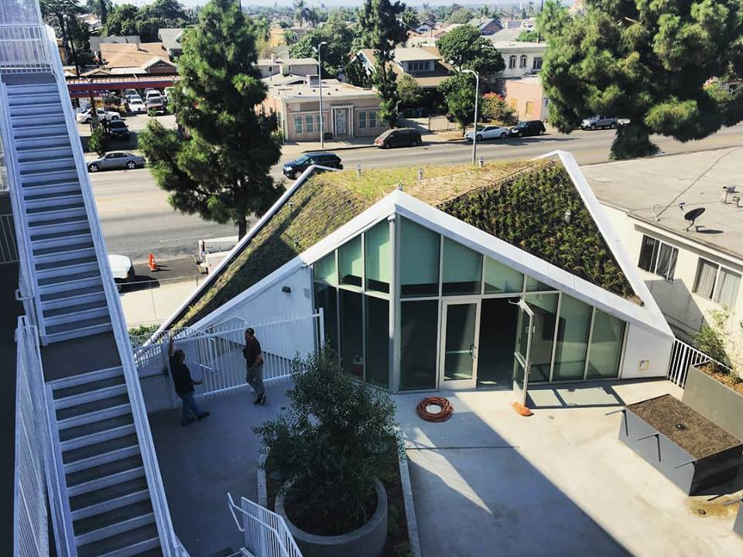
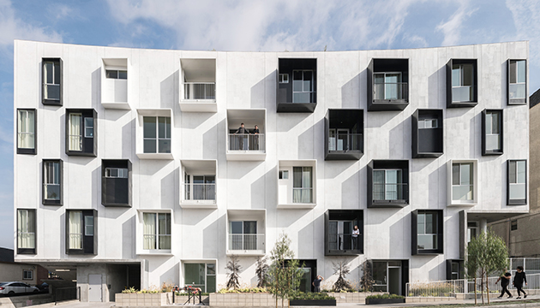
Lorcan O’Herlihy Architects [LOHA]:
Good design can also be cost effective.
  Case studies:
  MLK1101 and Mariposa1038

Slide 12
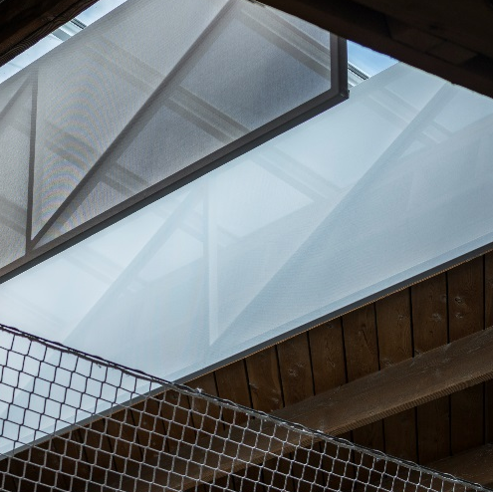
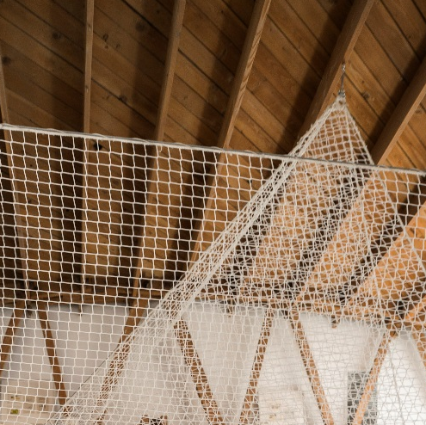
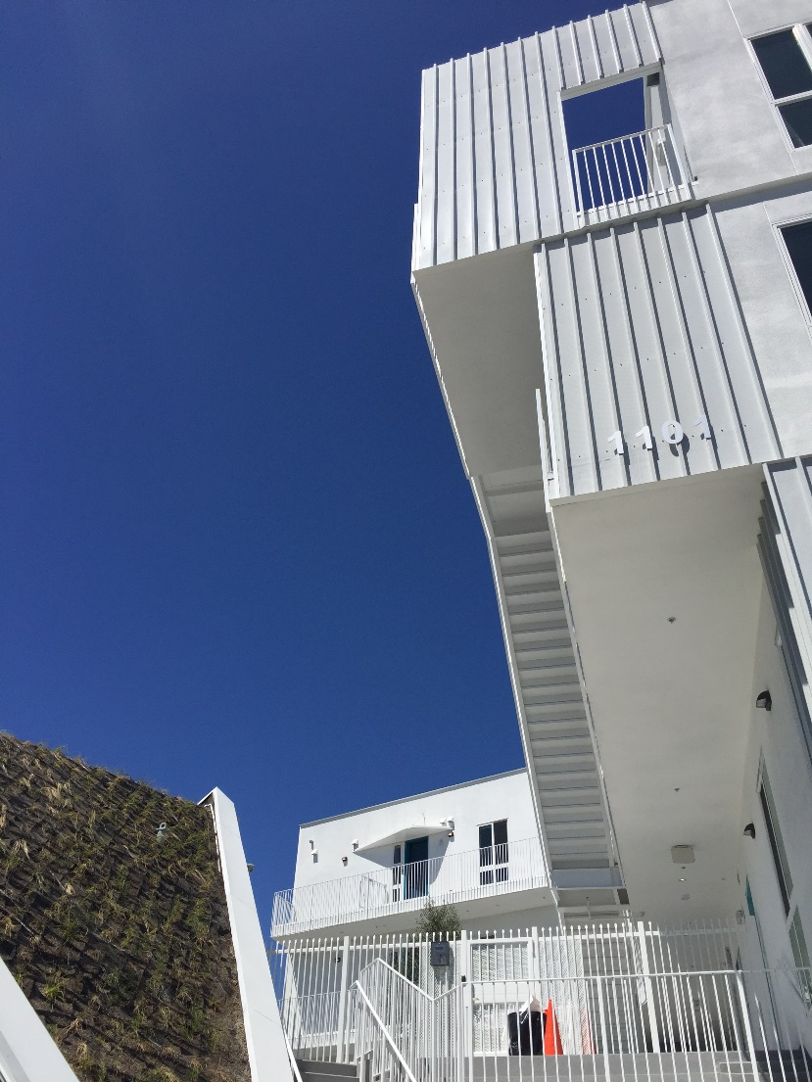
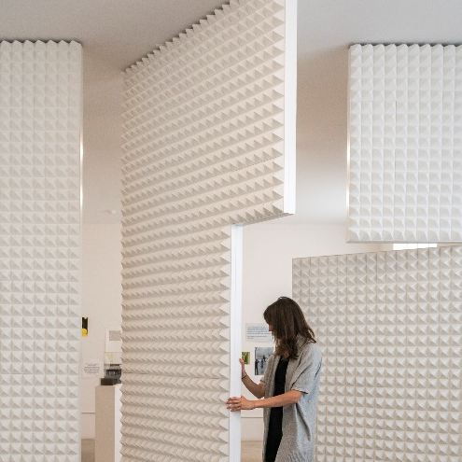
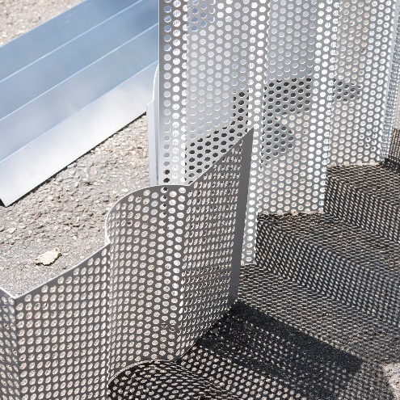
Unconventional use of affordable, off-the-shelf materials
The use of off-the- shelf materials such as the manipulation of conventional wood, metal, cement panels, and glass produces a distinct and vibrant identity for site’s overall environment.
Skylights: Fabric + Metal Frame
Guardrails: Netting + Steel Cables
Operable Partition: Acoustic Foam
Material Studies: Metal Panels
Stairs: Marine Board

Slide 13
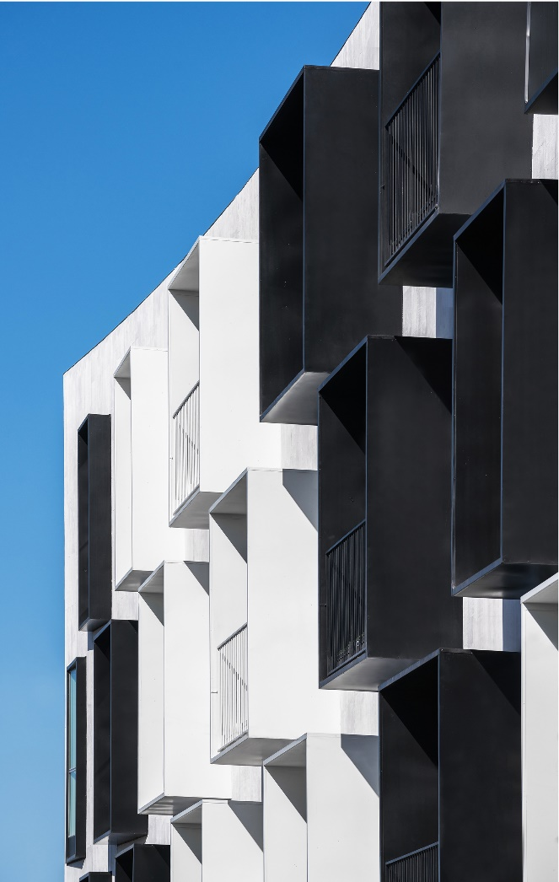
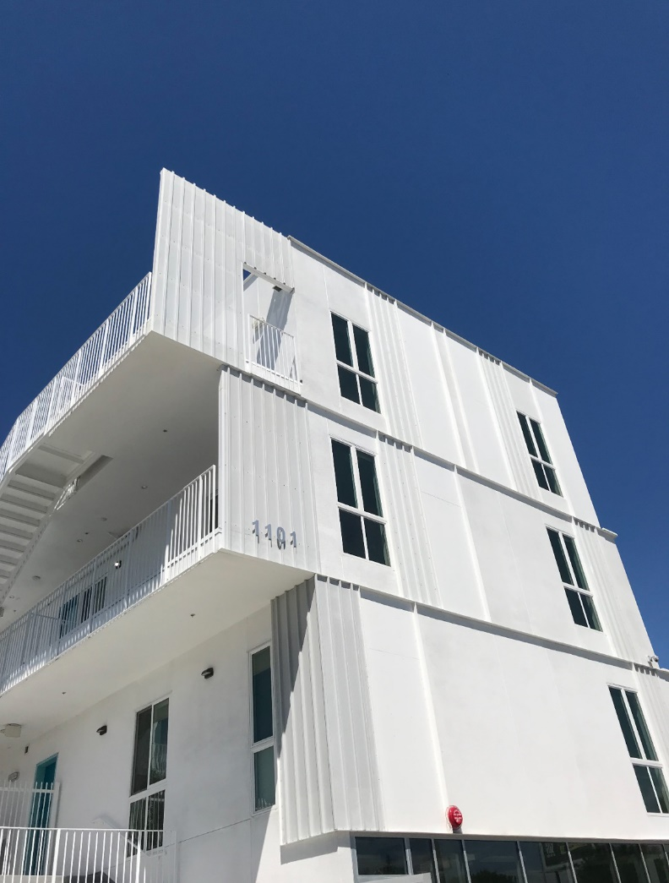
Varied repetition of standard parts
Done strategically leads to inventive solutions and uplifting environments for those in need.

Slide 14
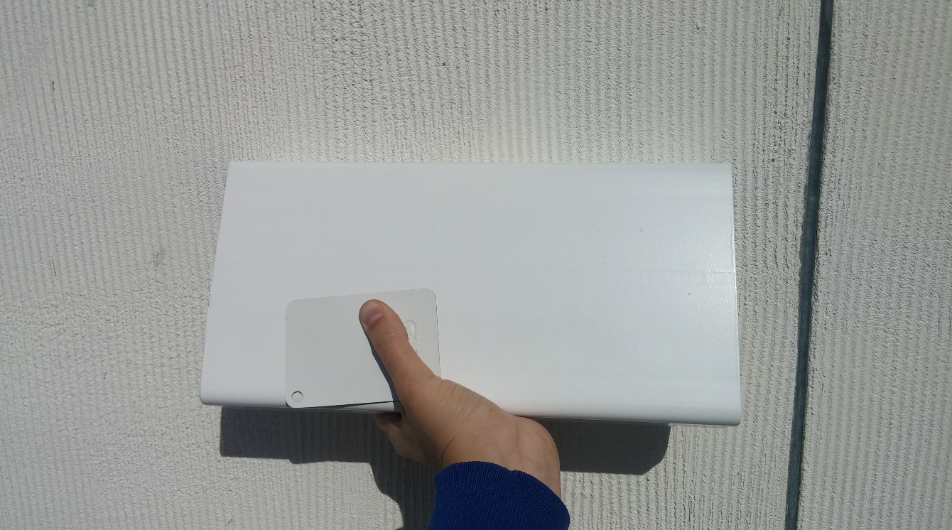
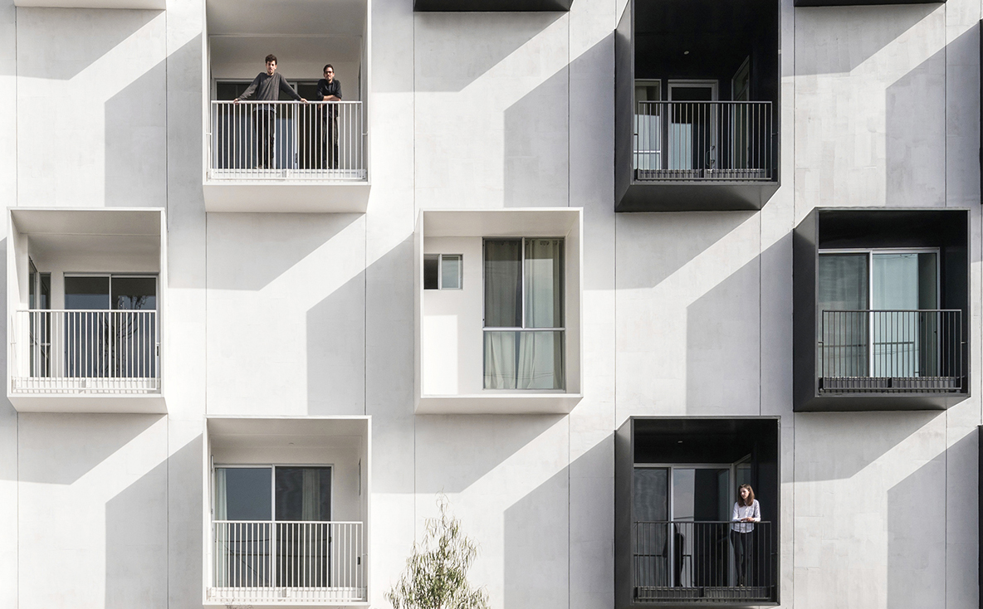
Maximizing simple details
For example, brushed plaster/stucco or implementation of color, can create opportunities for well-designed environments.

Slide 15
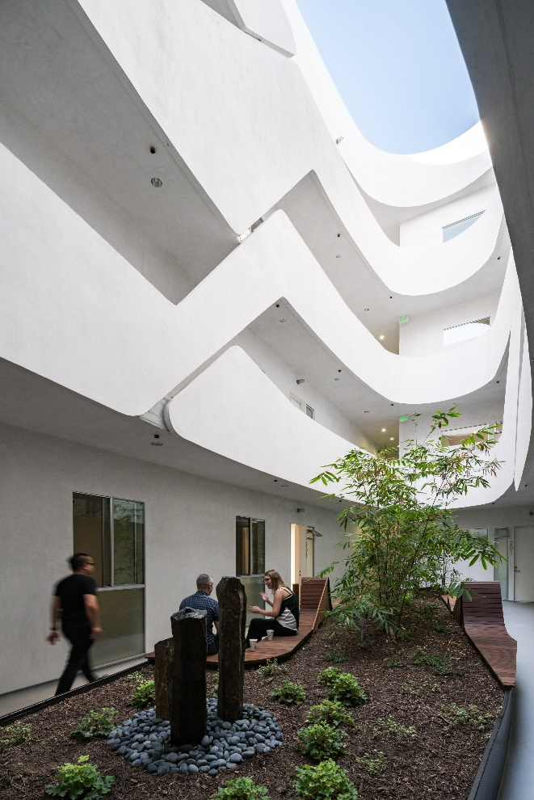
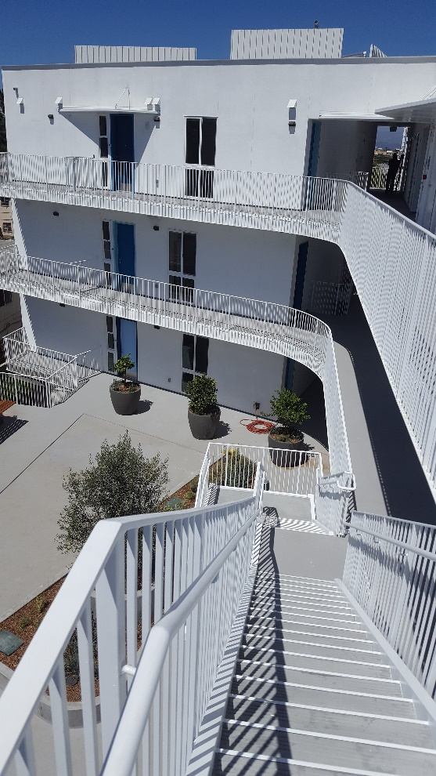
Cross ventilation & daylighting /
Exterior hallways
Cross ventilation reduces the need for heating and cooling, while daylighting decreases the need for artificial lighting.
The units are accessible by exterior hallways, which provide a source of daylight, and are more cost efficient than double loaded corridors with conditioned spaces. This creates an efficient ratio of rentable area to conditioned space.

Slide 16
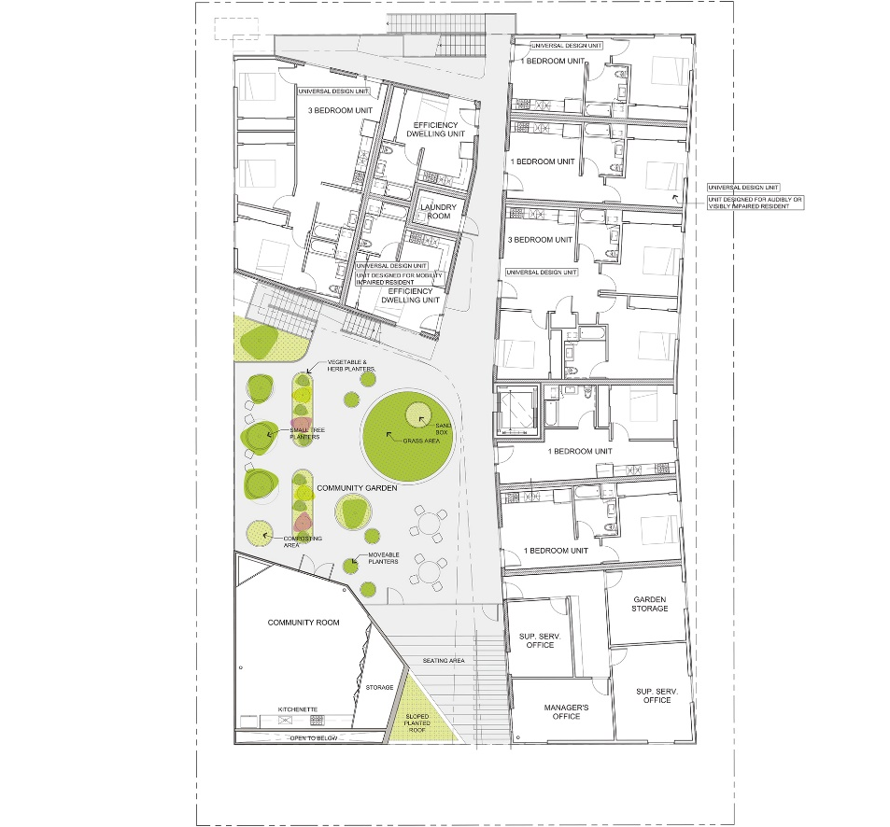
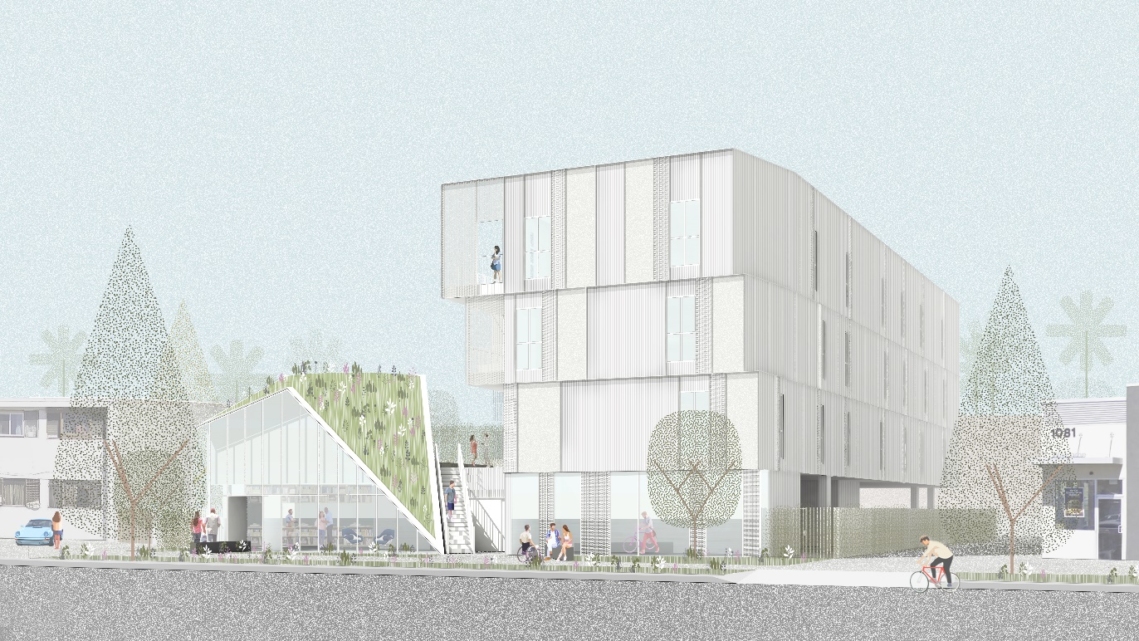
Structural Efficiency
Stacking bathrooms, kitchens and demising walls vertically is cost effective and does not effect the overall quality of design
Providing retail and visual access to raised courtyard from the street allows for efficient on grade parking vs. subterranean parking.

Slide 17
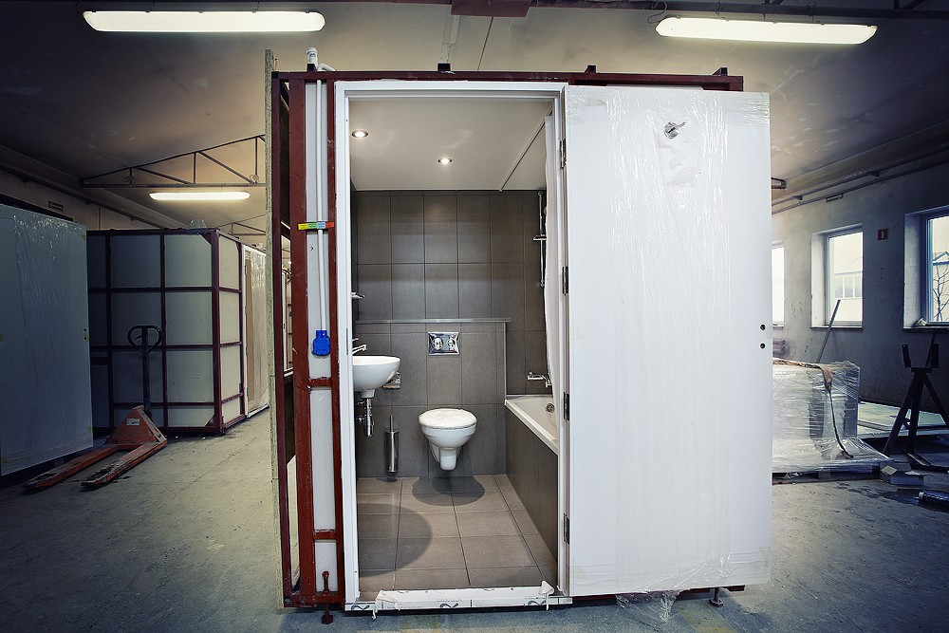
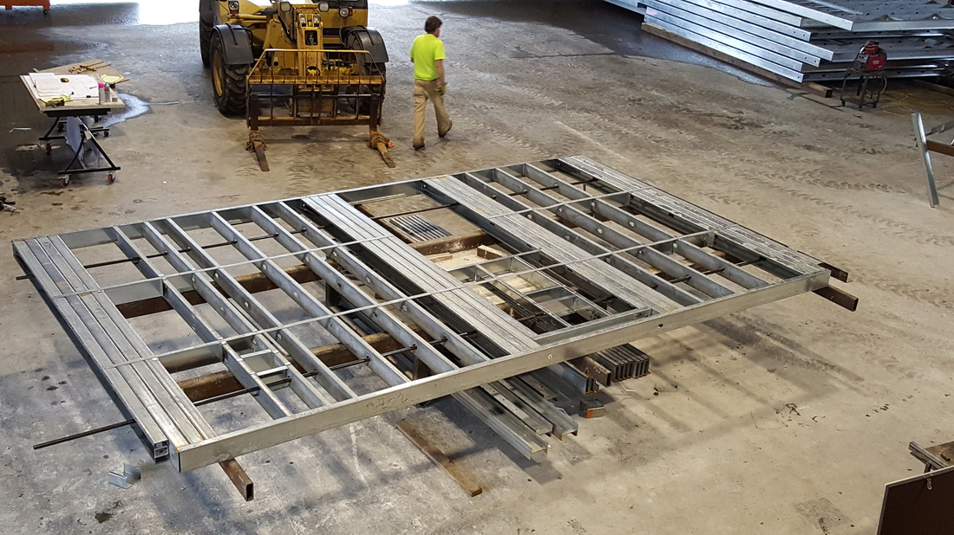
Other Strategies LOHA has used:
Utilizing prefab assembly to reduce the length of construction
Prefabricated Bathrooms
Prefabricated Walls

Slide 18
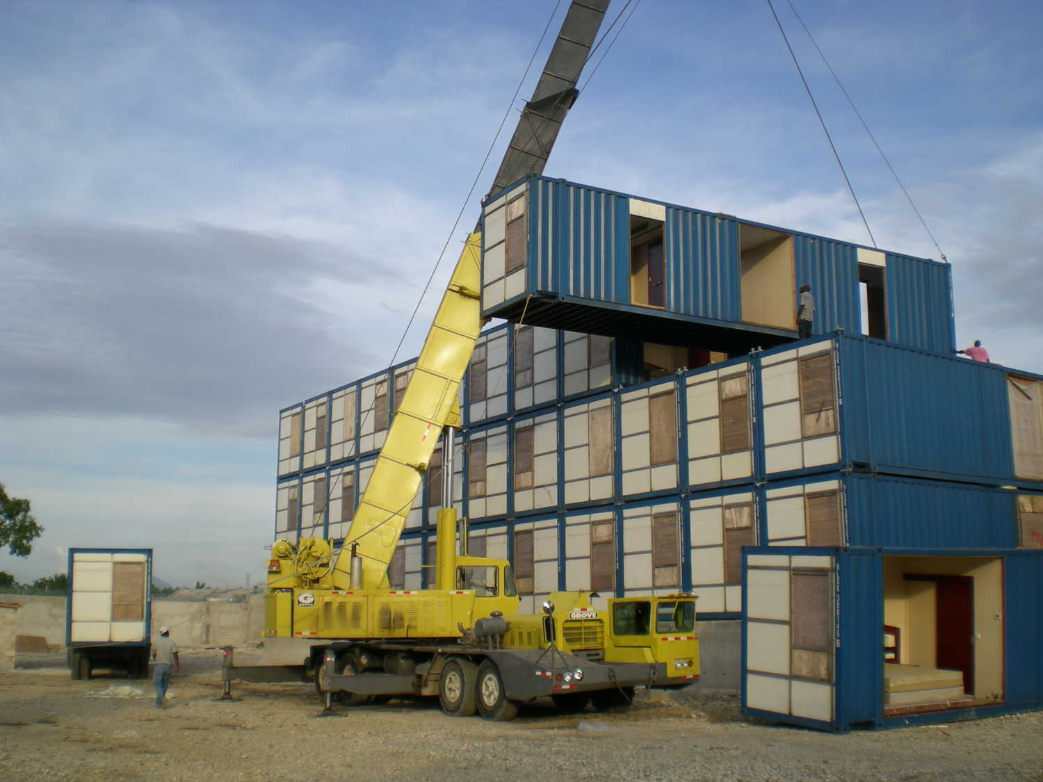
This strategy allows building at multiple scales
Prefabricated Shipping Containers

Slide 19
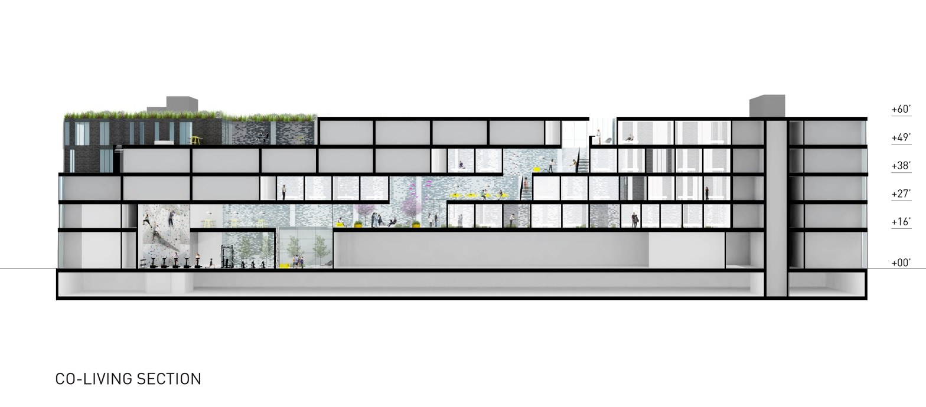
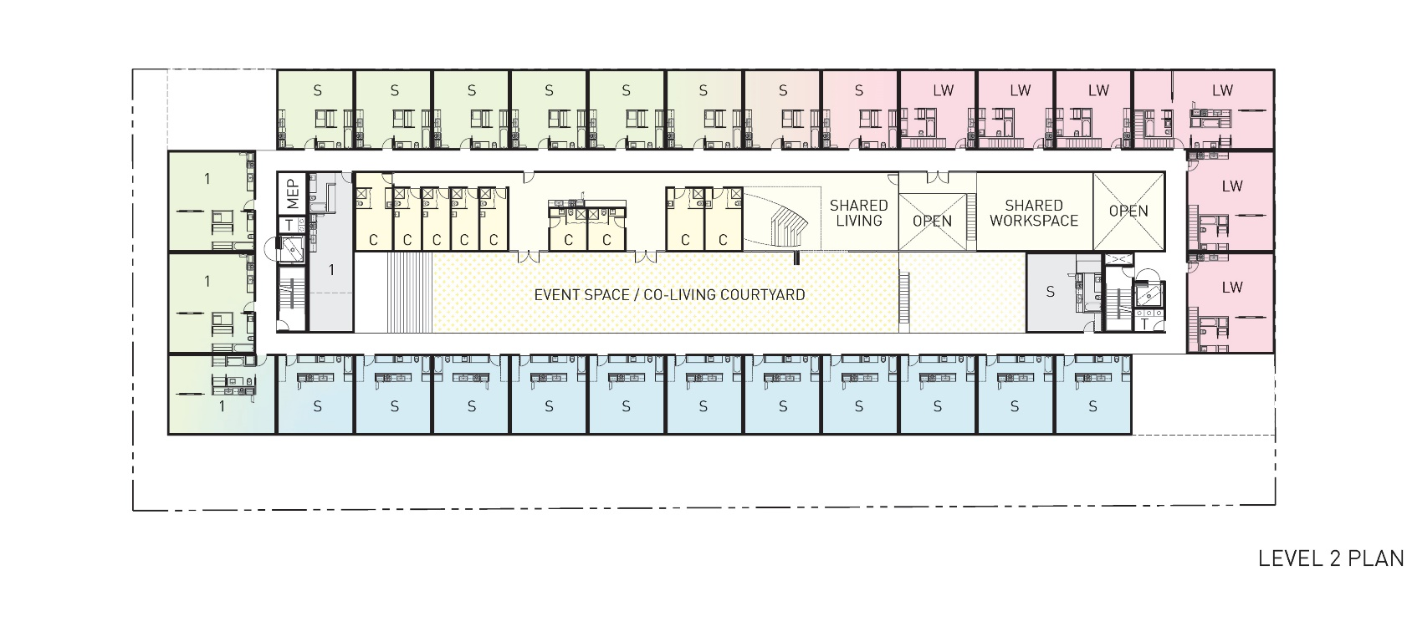
Micro-Units with Shared Amenities
Social gathering spaces are dispersed throughout the buildings and include common lounges, kitchens, study areas and outdoor patios.

Slide 20

Time Saving Approaches
  Increase 50% of TDC limit (HHH) to cover approximate 25% gap on a typical 4% LIHTC Structure
  Ensure site is by-right and is situated in at least a tier 3 TOC to maximize density and minimize parking
  +
=

Slide 21
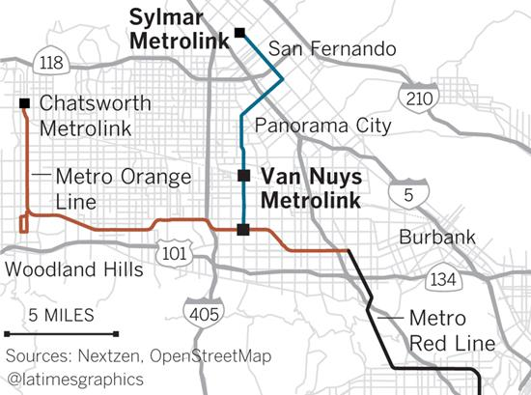
A new approach to the mismatch between available sites and favorable land use/TOC/Entitlements
Create inventory of City and County housing assets, large or small, that contain favorable land use and sit on high tier TOC for disposition.
If housing assets are minimal in fitting the above profile, City and County should coordinate with the MTA to identify future TOC (i.e. Van Nuys Light Rail) and purchase land with HHH thereby lining up future sites/projects and ensuring voters their tax dollars are hard at work

Slide 22
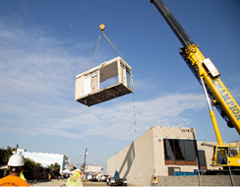
Ensure utilization of new Construction Typologies
Create new construction typologies that foster innovation and competitiveness, and diversify risk by removing dependency on one construction means.
Prefabricated Construction
Prefabricated Assemblies (bathrooms & walls)
Shipping Containers

Slide 23
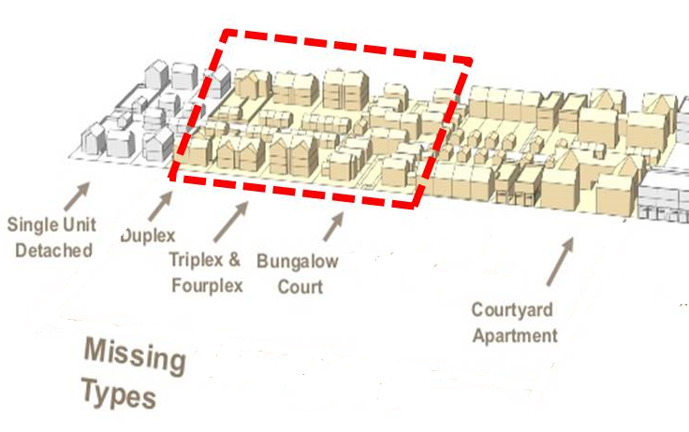
Creation of new non-LIHTC tools
Need to innovate new non-LIHTC tools for (a) smaller scale developments (1 to 15 units) that may be better suited for lower density neighborhoods in LA and are currently missing from the PSH landscape and (b) greater than 15 units projects.
Develop incentives for non-LIHTC developments that can be completed under 2 years. For instance, ½ an interest point for coming in 6 months earlier than 2 years up to a maximum of 1%.
Projects that are fewer than 5 units utilizing HHH should be exempt from securing a letter of Acknowledgement/Support
Create incentives for partnerships with Faith Based Institutions (FBI) & private sellers that are willing to provide a long term leasehold under rates yet to be determined, particularly for developments greater than 15 units.
Single Family Residence (SFR) & ADUs
Duplex, Triplex, & Fourplex
5 to 15 units
Over 15 units (FBIs & Private Sellers)

Slide 24
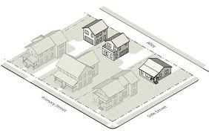
Creation of new non-LIHTC Tools (Cont.)
SFRs & ADUs
Modify current $100k/unit for non-LIHTC projects to $100k/bedroom when applying to SFRs and ADUs. Therefore, this method creates an incentive to effectuate bigger SFRs and ADUs
Duplex, Triplex and Fourplex (under 5 units)
Allow increase from the current $100k/unit for non-LIHTC projects to $210k/unit, provided each unit is at least a two-bedroom unit or the average bedrooms per unit of the entire development equals two per unit.
5 to 15 Units & Greater than 15 Units Developments
Allow increase from the current $100k/unit for non-LIHTC projects to $180k/unit.

