Slide 1
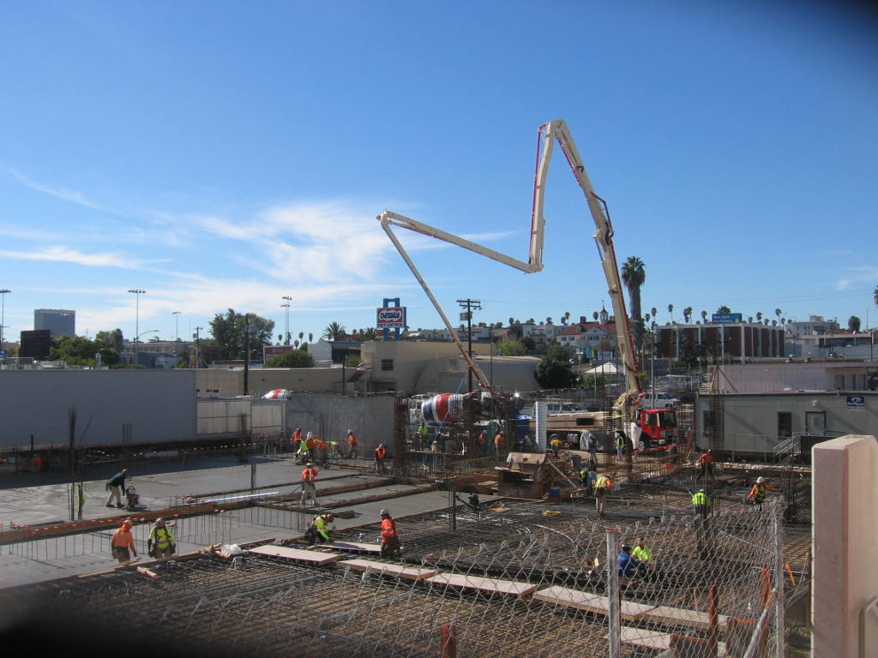
Path Metro Villas II – 22% Complete
Path Metro PH 2. View from 325 Westmoreland Ave.
Cement trucks are at 320 Madison Ave.

Slide 2
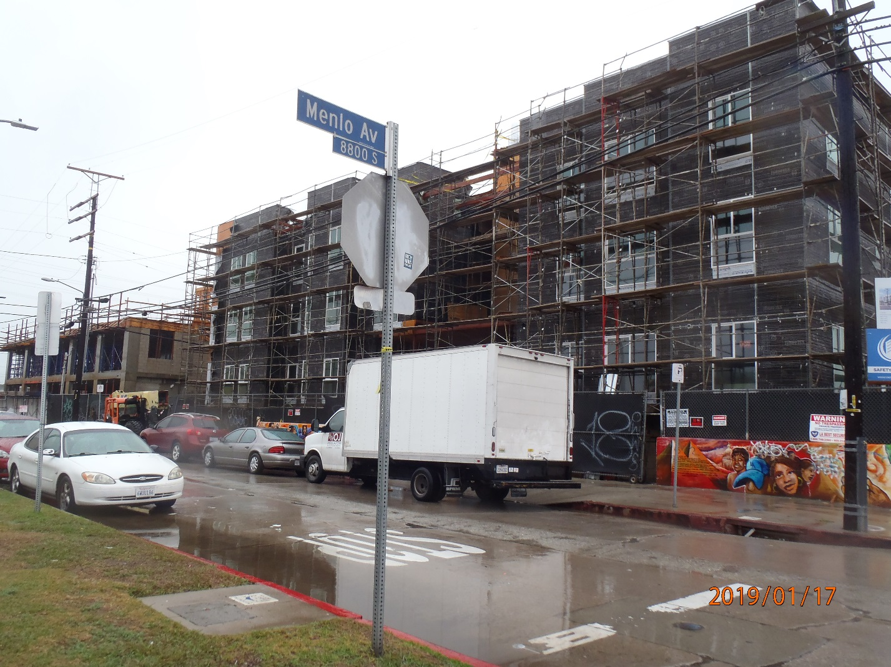
88th & Vermont – 41% Complete
88th and Vermont Apartments view from Menlo & 88th

Slide 3
649 Lofts – 33% Complete
649 Lofts view from diagonal corner of 7th & Wall St.

Slide 4
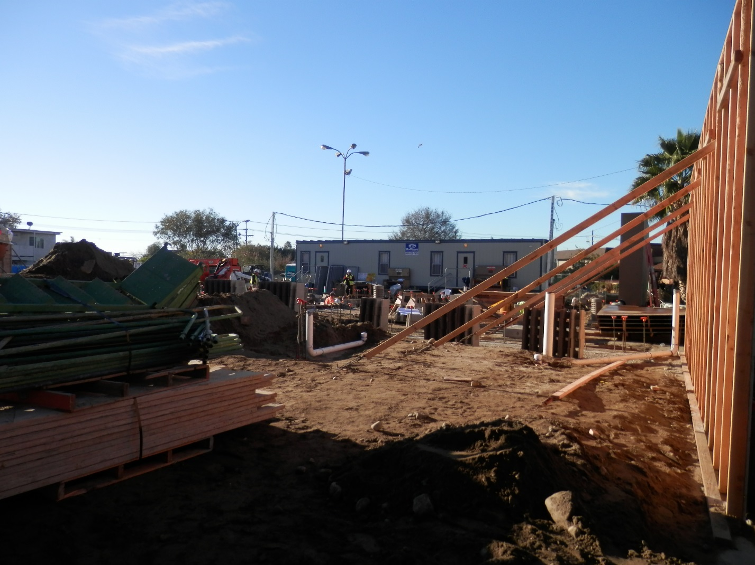
Casa del Sol – 2% Complete
Casa del Sol view from just inside the sidewalk of situs.

Slide 5
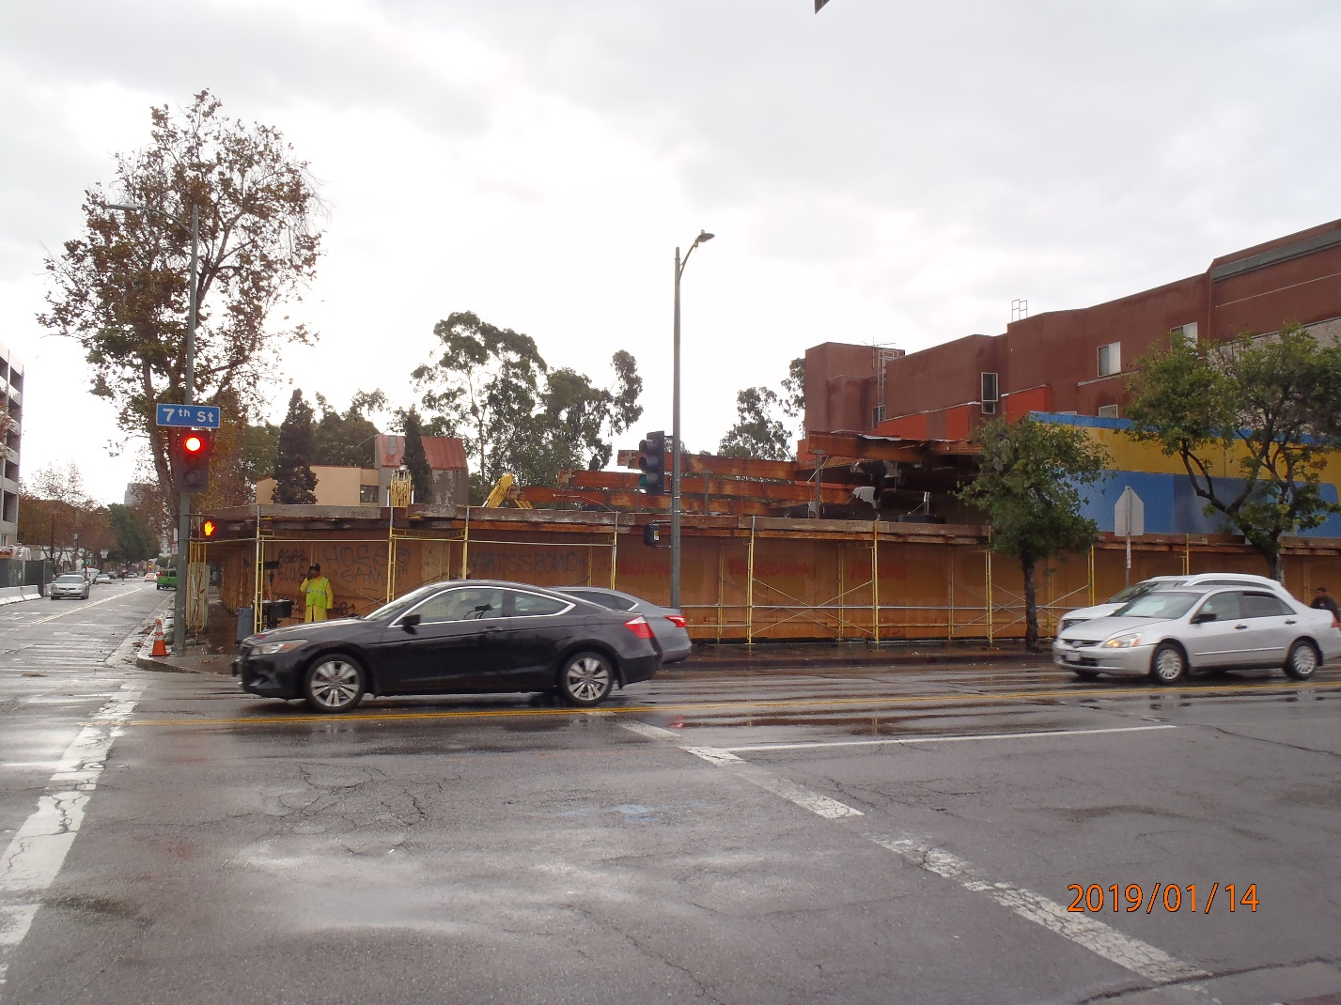
Flor 401 Lofts – Construction Pending
View from across the street on 7th St. Demo almost complete.

Slide 6
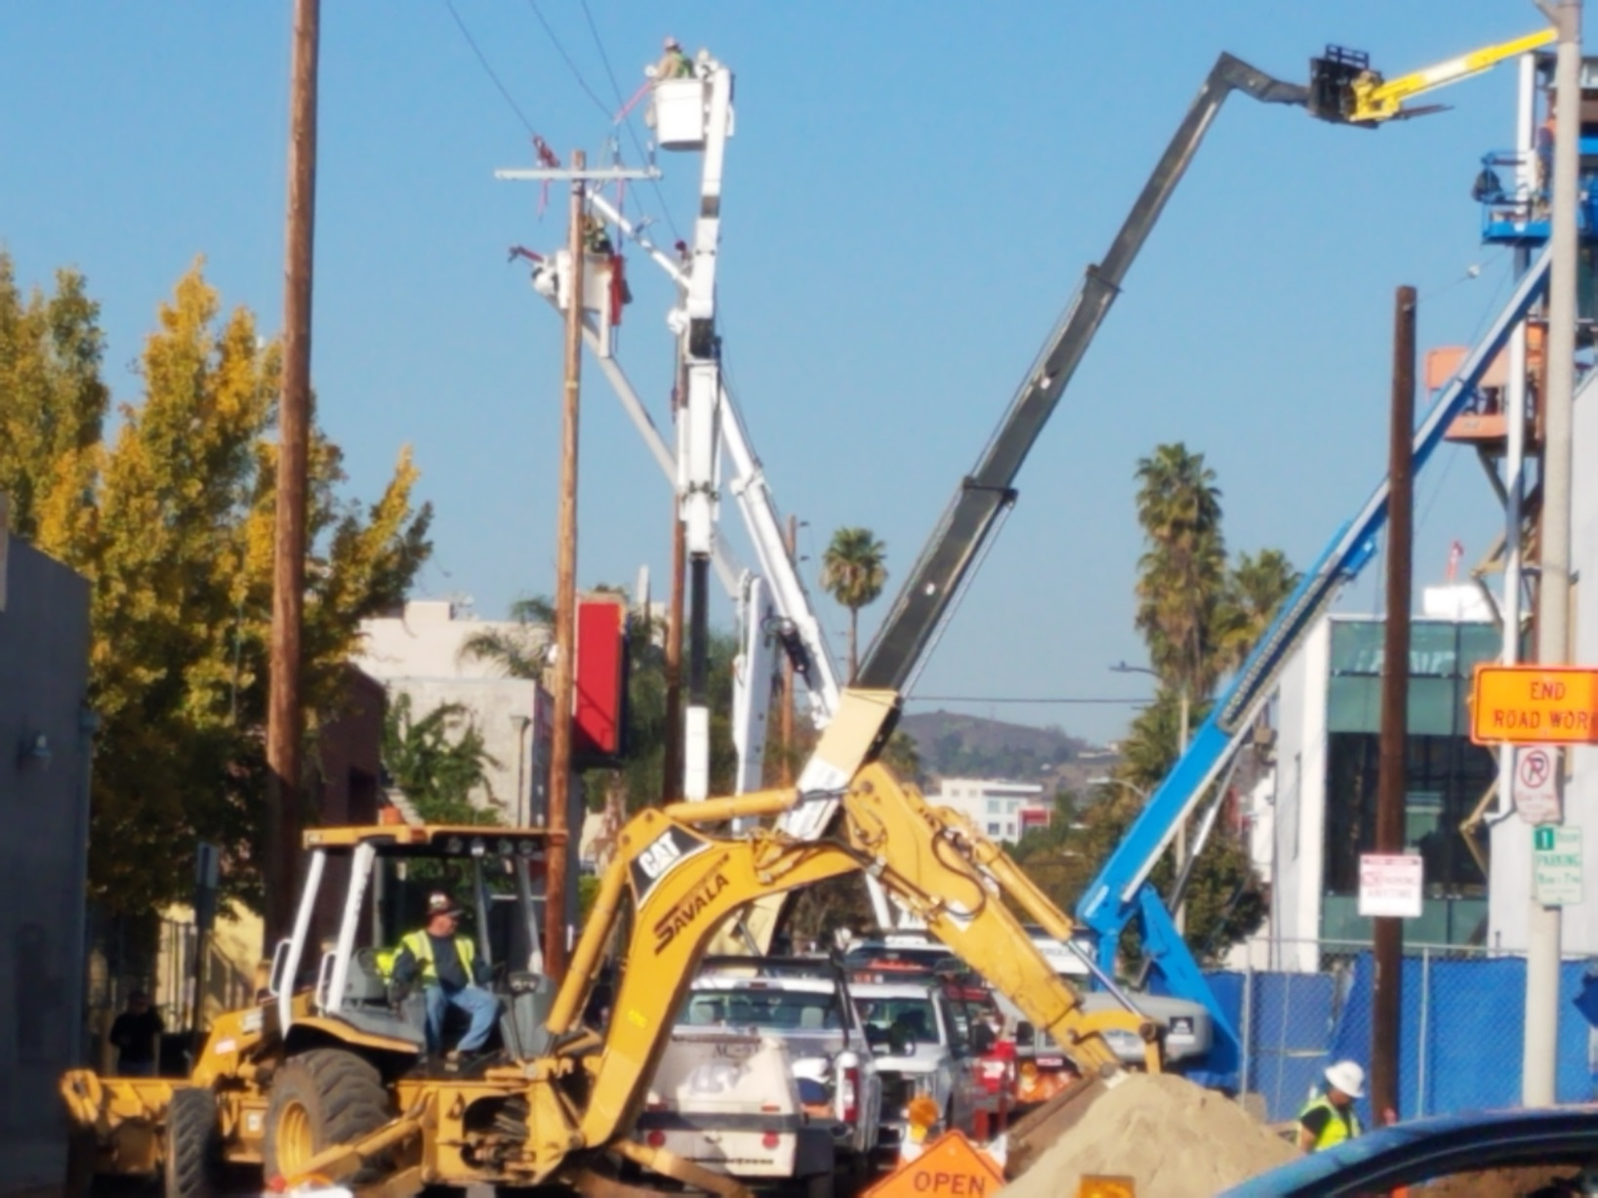
McCadden Plaza Youth Housing – Construction Pending
View from front of situs.

Slide 7
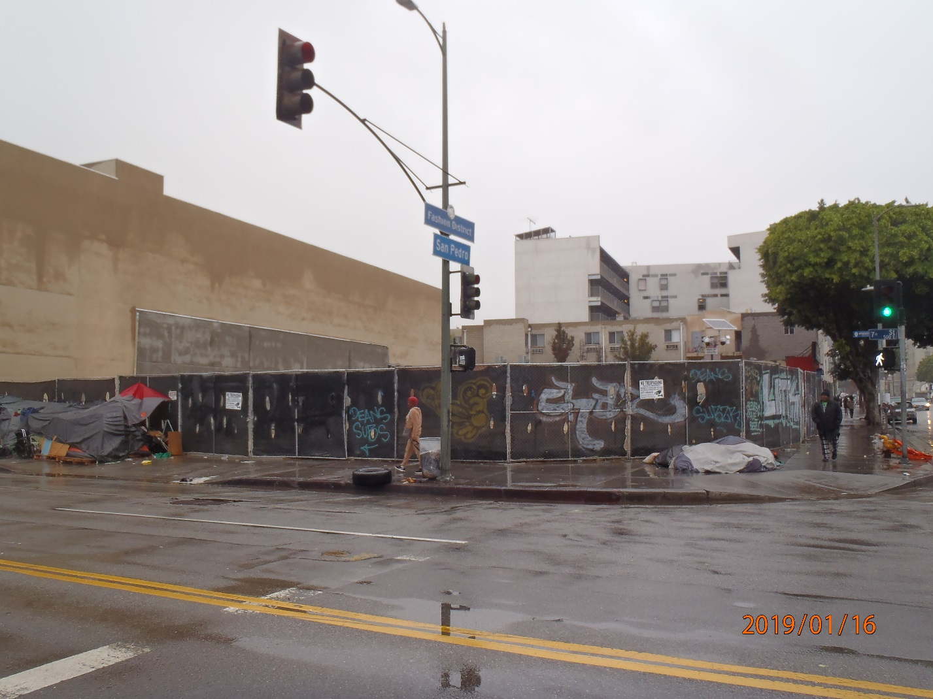
SP 7 Apartments – Construction Pending
View from across the street at 7th and San Pedro.

Slide 8
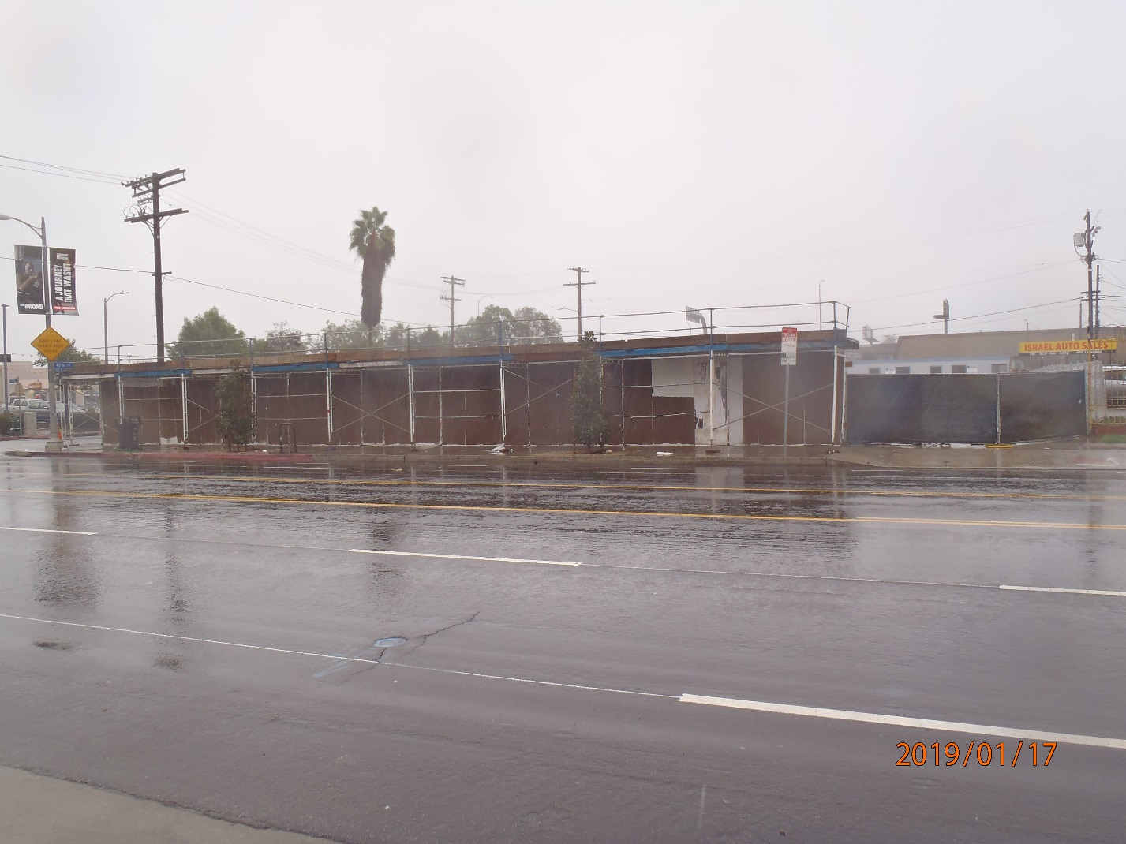
RISE Apartments – Construction Pending
View from across Figueroa and 40th Pl.

