Slide 1





EVERYONE HAS A STORY
A Qualitative Examination of the Homeless Experience in the City of Los Angeles: Toward Tailored Solutions
Phase 1 Findings & Next Steps
Presented to the Homeless Strategy Committee
~
Dr. Cheryl Grills
Dr. Elia De La Cruz Toledo He
Dr. Riley Sohail
February 12, 2026
Psychology Applied Research Center

Slide 2
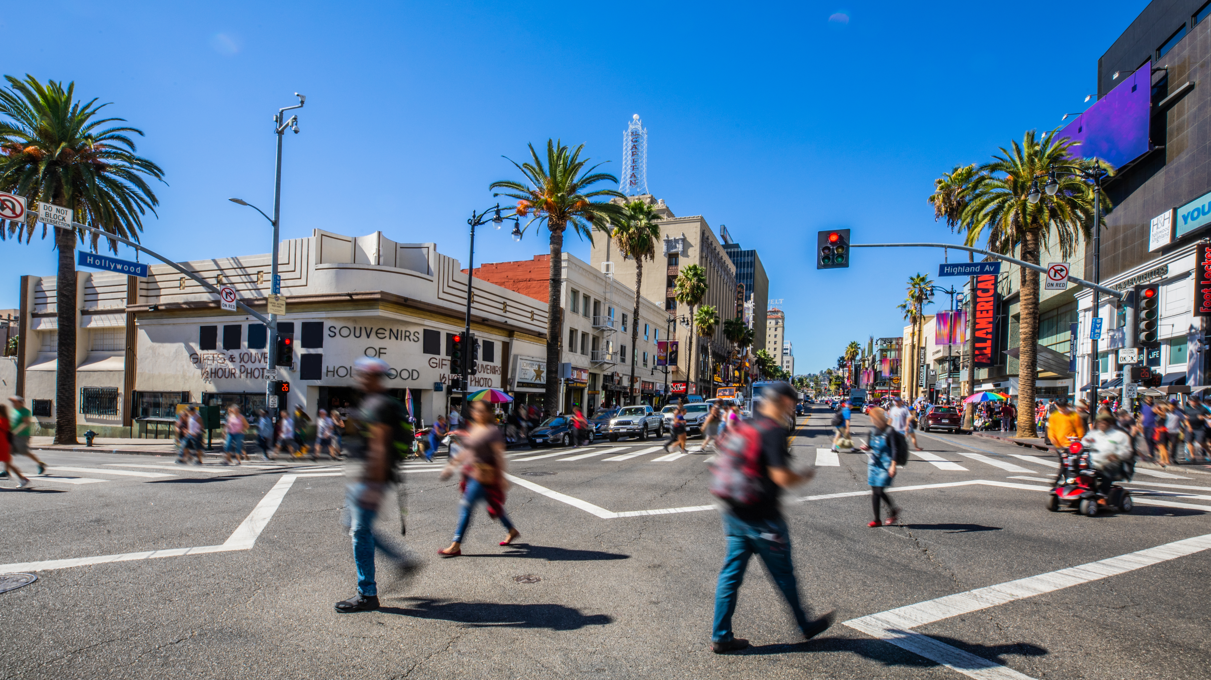

PEOPLE WHO ARE HOMELESS ARE NOT SOCIAL INADEQUATES. THEY ARE PEOPLE WITHOUT HOMES.”

Slide 3
Research questions & Goals
What are pathways
INTO
homelessness?
Goal: To understand the drivers of becoming homeless to help high-risk Angelenos prevent occurrences or reoccurrences (i.e., to reduce the flow of individuals and families who enter homelessness or cycle in and out of homelessness).
What are pathways
WITHIN
systems that must be navigated by PEH?
Goal: To understand PEH experiences in relation to city and county efforts to increase the number of individuals who transition to permanent housing and self-sustained housing.
What are pathways
OUT
of homelessness?
Goal: To identify the factors that impede or facilitate movement from unhoused to interim housing with services and self-sustained permanent housing.

Slide 4

"When a complex system is far from equilibrium, small islands of coherence in a sea of chaos have the capacity to shift the entire system to a higher order." Ilya Prigogine

Slide 5
Phase 1: Rapid Scan Methods and sample
72 Participants
51 People Experiencing Homelessness
24 individual interviews
27 in 4 focus groups
7 Elected Officials
11 Service Providers
3 City Department Representatives
Participant Demographics
43 Average age
77% Female
63% Black/African American or Latinx
50% Have dependents under their care
32% Currently employed (full or part-time)
41% Not working but actively seeking employment
46% Reported one or more health conditions

Slide 6
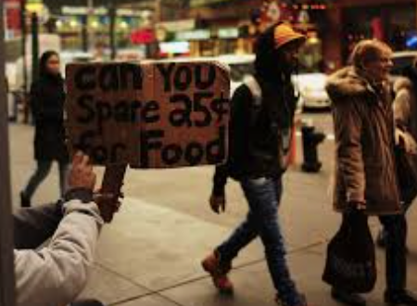
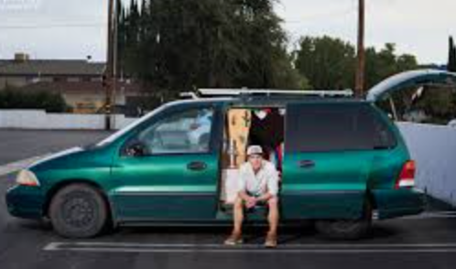
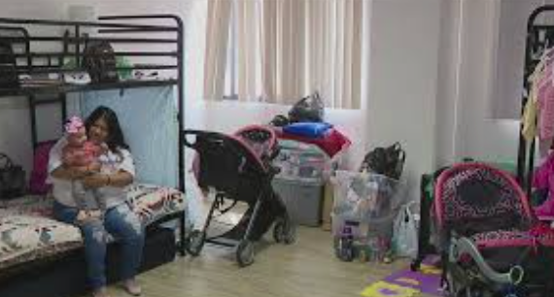
Key takeaways
REFRAME the problem
01
Commonly cited causes need to be interrogated
REPAIR the pipeline
02
Pathways out require multiple, coordinated, and diverse forms of support
REIMAGINE investments
03
Lack of affordable housing is a key driver of homelessness
City and City-County service fragmentation must be addressed to seal the cracks into which Angelenos in need fall
Presence of multiple pathways conflicts with a one-size-fits all approach
Effective interventions require both quantitative and qualitative data and data sharing
Consider adding evaluation of outcomes
Access the research talent in LA City and County

Slide 7


WE HAVE DEFINED AN INCREDIBLY VARIED GROUP OF PEOPLE BY THEIR LACK OF ONE PHYSICAL NEED: STABLE HOUSING. ”
I do have a job. Like, I just don't have nowhere to live.… But there's so many reasons why we can't get apartments this year, like credit issues .… because I run out my credit cards being homeless, so that messed my credit up. Then I'm trying to keep my car.... Just because we don't have a house, that doesn't mean … we're bad people…. I think everybody just thinks, like, oh, they're on drugs, and they should do better, just go get a job, like, that's just gonna change your life. No, it's just income. There’s so many other things that come with obtaining housing, you know?”
- PEH
PEH want to be seen, heard, understood, respected, and included in the circle of humanity.

Slide 8

Myth: drugs and mental ILLNESS drive homelessness
Fact: There is no empirical evidence to substantiate this convenient figment of our society’s imagination
Fact Checking Urban Legends
MYTH: UNHOUSED PEOPLE ARE LAZY, AND SPEND ALL DAY LOOKING FOR DRUGS AND SHIRKING RESPONSIBILITY
FACT: Unhoused people spend their days seeking shelter, safety, medical support, a way to protect documents, and connection with community

Slide 9
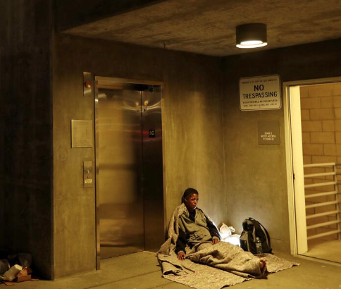
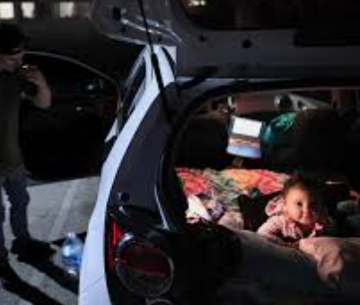
Pathways into homelessness
The Downward Path:
Gradual erosion of resources
Pushed with No Net:
System failure at a critical moment
The Perfect Storm:
Multiple proximate crises

Slide 10
Downward path: *Sherry’S STORY
“[The public thinks] everyone is lazy, and that they want to be homeless because they aren't trying to find work, they aren't…you know, pulling up their bootstraps, quote-unquote, you know, and we just aren't trying hard some of us. Some of us are trying, and we're just… we just have doors continuously being shut in our faces. Not everyone is a drug addict.” (Sherry)
Loss of income leads to loss of resources: car, healthcare, and eventually, housing. Coupled with housing and cost of living, in a crescendo, one loss triggers another.
Sherry is now in interim housing but has little faith in the system due to the living conditions and fragmented services.

Slide 11
THE PERFECT STORM: *Janet’s story
“So not all of us that are in shelters are there for drugs or things like that. It's just an unfortunate situation. ….It's like I thought I'd be married forever, and I would die with my husband, but he had a massive heart attack….. And we lived an amazing life before and I handled things not right.” (Janet)
Multiple crises co-occur or happen in rapid succession
This is what happened to Janet:
  Her husband had a massive heart attack and passed – with no life insurance.
  Janet discovered she owed over 1 million dollars and taxes & was the sole provider for 5 children.
  Janet began to drink excessively and got three DUIs, landing in prison.
  She moved to California in shame and ended up renting an apartment with a stranger she met working a part-time job.
  Janet fell ill and was still working, selling items online and struggling to make ends meet.
  One day, Janet discovered that her roommate was secretly filming her in the bathroom.
  Janet fled and from then, entered the shelter system, too traumatized to ask for help from friends.

Slide 12
PUSHED WITH NO NET:
*Isaac’S story
“It’s hard to deal with the way the system is. When you deal with people, you have to prove that you’re hurt. They take you [through] so many hoops to get a benefit that you deserve.” Isaac
When there is a systemic failure, vulnerability to homelessness rises.
Meet Isaac:
  Isaac was a Navy veteran who struggled to find employment after returning from service. He was able to secure employment trucking but was injured on the job. His worker’s compensation was repeatedly cut off, in part due to delays in treatment and incorrect clearance to work. Unable to work or receive consistent income, he became homeless.
  He connected with VASH (a housing subsidy program) but spent nine more months in his van because worker’s compensation was not considered income for the program.
  His application for VA disability was denied, until 13 years later, when he finally learned how to share his story in a way that would fit on paper. This means he did not receive any disability pay for the 13 years that he could not work due to his service-related PTSD.

Slide 13
no one-size-fits-all: Population Differences
Intimate partner violence (IPV)/Domestic violence
  Perpetrators often isolate individuals and undermine their social and economic support systems
Elders
  Adults over 50 make up nearly 40% of those needing shelter
  Supplemental Security Income and Social Security Disability Insurance are fixed, and often fail to meet rising rent costs
Systems-involved youth and adults
  The transition out of the child welfare system or incarceration can be fraught with gaps in institutional support
People with physical health/disability
People with mental health & substance-use disorders
People with a cycle of behavioral health and trauma
  Trauma and stress from family and/or economic instability can trigger or exacerbate psychiatric symptoms

Slide 14
THE THROUGHPUT BOTTLENECK
Interim Housing
Streets/Cars/Couches
Permanent Housing
Can provide critical stabilization and access to services
“I heard that they had this program that they can put you in a permanent hotel room…. They never got back to me about it.… It's just so much red tape." PEH
“I'm trying my best to dig out myself because I can't count on anything that's going to happen that they tell us is going to happen. They're just saying it's a lottery and you might get matched, and you might not, and you're only supposed to be here 90 days. But there are people that have been here three years.” PEH
As one elected official stated:
"If people remain on the streets longer, they'll recycle into the system more frequently. If exits aren't to housing, they go generally back to the street."

Slide 15
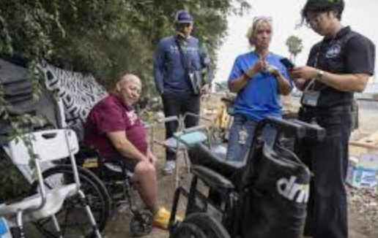
System NAVIGATION challenges
Systemic and structural bottlenecks
Documentation and paperwork
Falling through the cracks
Needed support services
“Without all of the needed documentation, we can't get people into permanent housing.” Provider
One IPV survivor shared that she went to get admitted into a DV shelter but was denied because a facility in Atlanta cashed a check to cover her staying there. She never stayed there. She never got admission into a DV placement in LA.
(Different systems need to be connected. The systems failed her.)

Slide 16
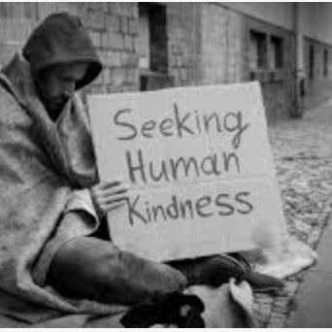
current system Hurdles
Limited Coordination & Inefficiency
Ineffective Care & Frustration
"The county is an organized bureaucracy, extremely slow, lacks innovation. The city can move more quickly, is more innovative, but is chaos. They don't talk to one another. We have to talk to four departments to get anything done."
— City Department Representative
“I had, like, 40 people ready to move in this place. They didn't move in, some of them blamed me for it, some of them blamed her, but the bottom line is, they didn't get them, and they're still homeless.” Provider

Slide 17
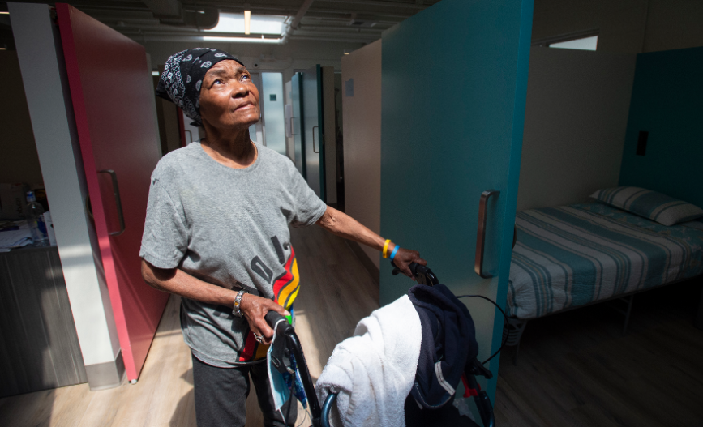
Promising practices
Interim Housing
Flexibility & Responsiveness
Collaboration
“One thing really is we can't do it alone, so the organizations cannot do it alone. So, we do need that collaboration and the partnership and to come up together to identify our top priorities and how do we manage as a collaborative partner across the county and city and allocate buckets of dollars to these priorities. That is a system-wide priority. ” - Provider

Slide 18
Key takeaways & recommendations
Reframe the Problem
Prioritize housing affordability and availability
Meet pressing needs (e.g., health care, employment, transportation, etc.)
Repair the System
Unify data systems
Define and provide comprehensive services in IH and PH.
Reimagine Investments
Track people, not just aggregate numbers (include qualitative data)

Slide 19
Everyone has a story: more to come
“I wish they could see underneath the shell and this mask that I’ve had to put on all these years and see the true heart of the person that I really am. All I’m really trying to do is survive.” - PEH
Potential research foci
Further examine pathways into and in homelessness and pathways out across different populations
Cost Benefit Analysis: Embracing Simplicity
Collaborations
Align qualitative research with HR&A performance measures triangulating qualitative and quantitative data
Collaborate with USC Homelessness Policy Research Institute and UCLA Periodic Assessment of Trajectories of Housing, Homelessness and Health Study (PATHS)

Slide 20
NEXT STEPS OF Collaboration WITH UCLA & USC
Periodic Assessment of Trajectories of Housing, Homelessness and Health Study (PATHS) conducted by PATHS: Drs. Randall Kuhn & Ben Henwood
  Longitudinal, monthly panel survey of PEH - started 2022
    Collected 17,000 monthly surveys and 2,000 semiannual surveys from 1770 respondents
  Encampment Resolution Program Evaluation began August 2025 measures retention and flow
  Trend the trajectory into, in, and out of homelessness with person level data in contrast to a snapshot in time
  Exploration of quality of life perceptions including health related data mapped onto individual trajectories

Slide 21
Thank you!

